Slide 1
CSC3001 Discrete Mathematics
Tutorial 1

Slide 2
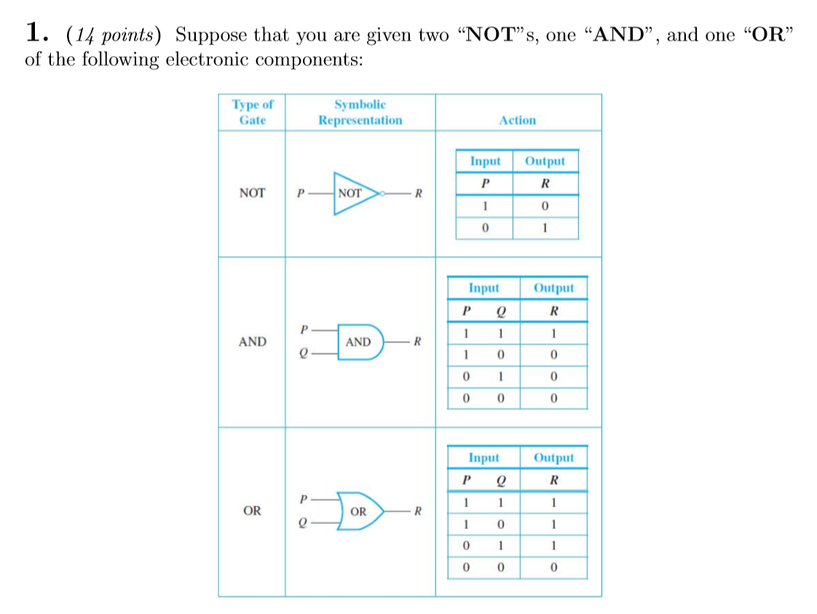
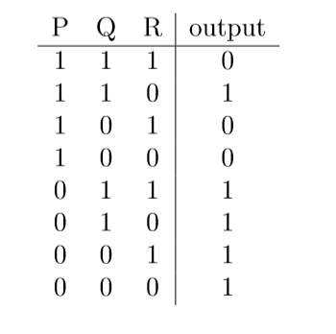
Question 1
Design a circuit so that it has the following input/output table.

Slide 3
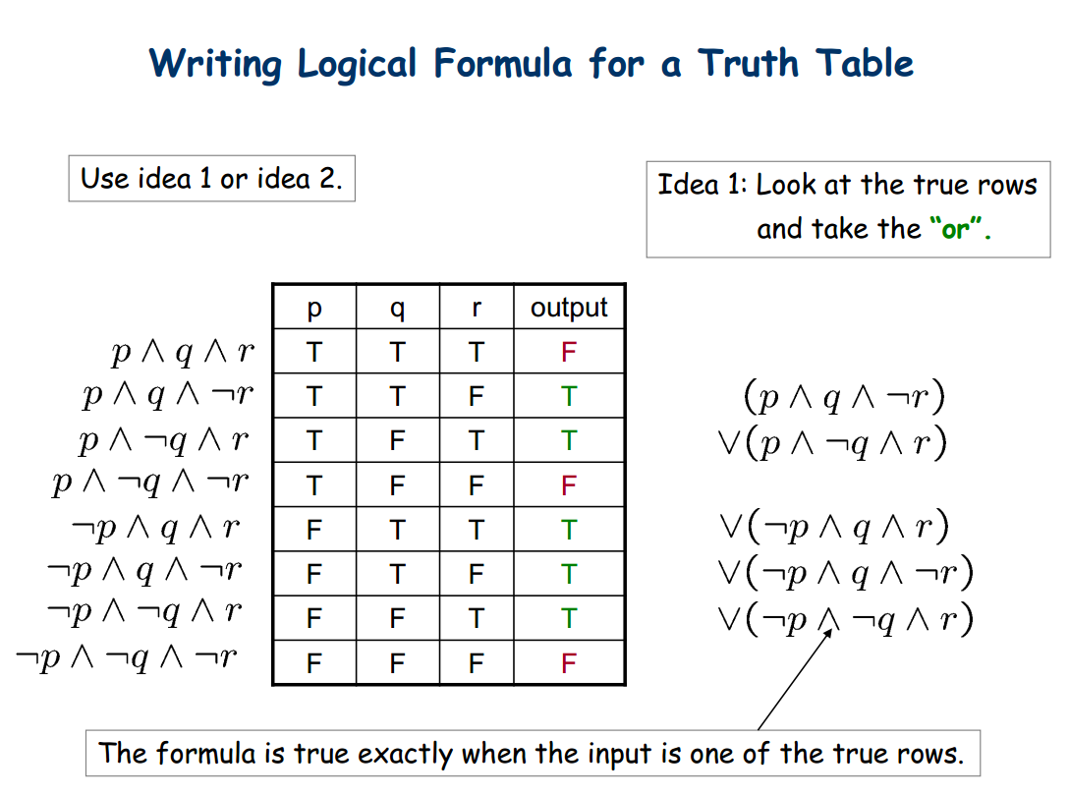

Slide 4
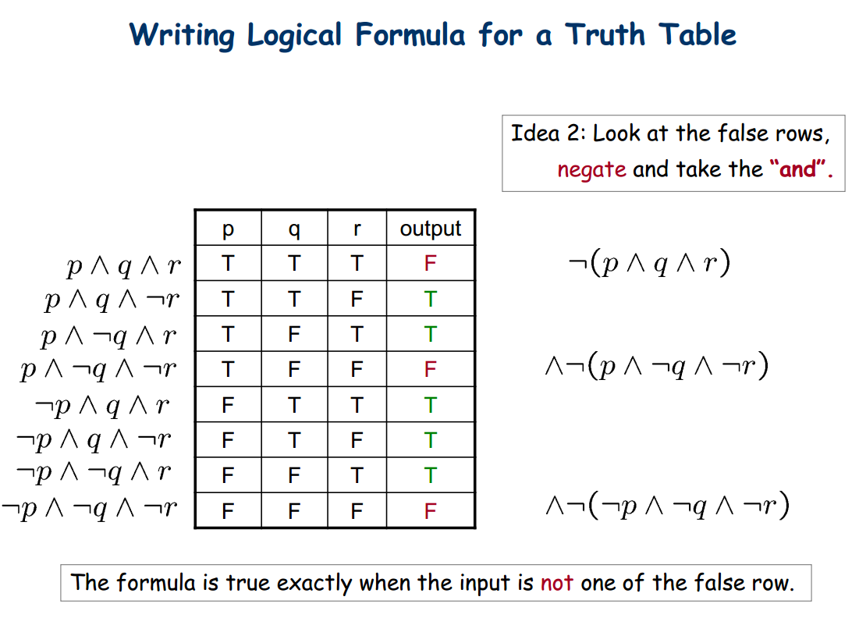

Slide 5
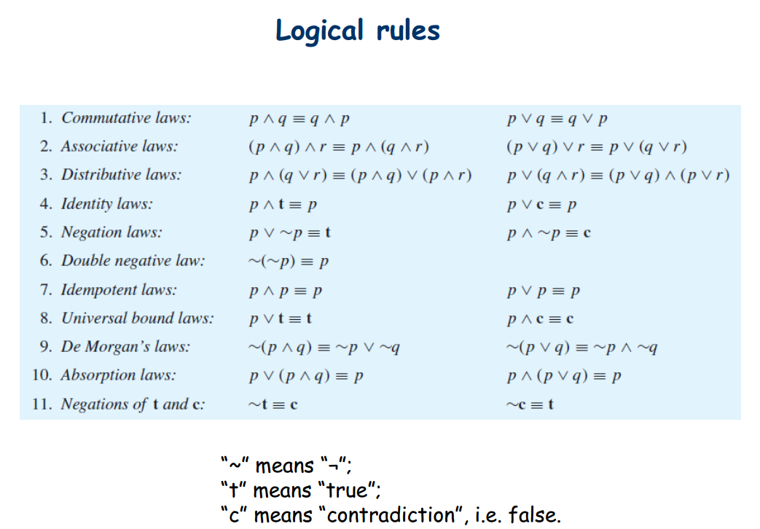
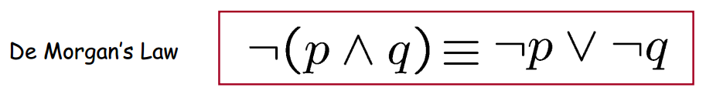
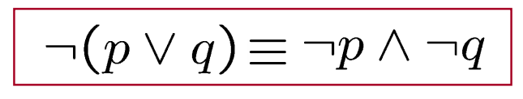

Slide 6
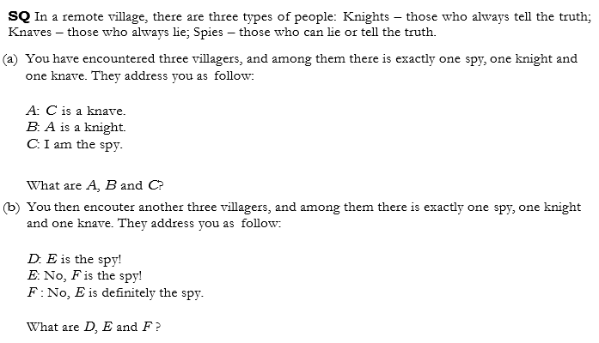
Question 2

Slide 7
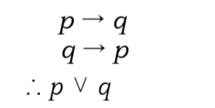
Question 3
(a) Determine whether the following argument is valid by truth tables.
(b) Decide the following statement is true or not.

